Slide 2
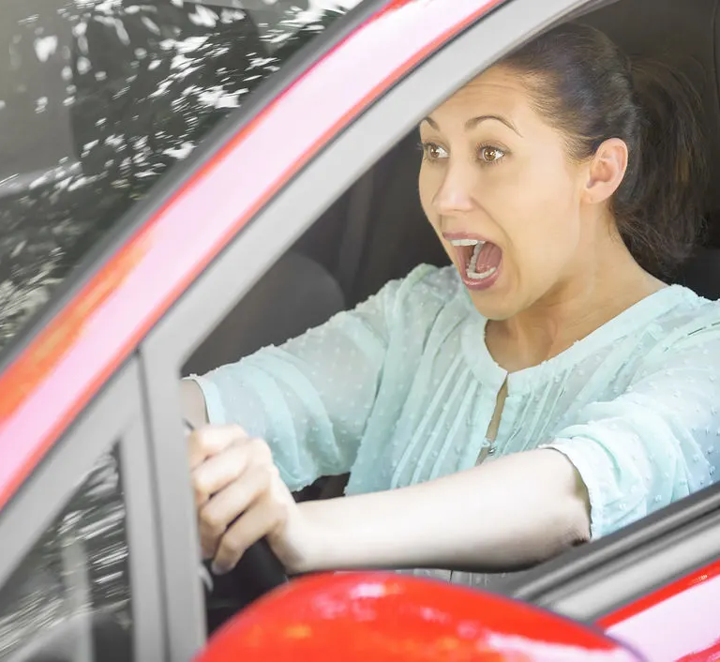
BRAKE FAILURE
5% Of Accidents!
300,000 people!

Slide 3
A Persons Spiritual Brakes Go Out!
2 Peter 2:12-14
  Filled with sinful thoughts – involved in sinful activities – they CANNOT STOP!
  No reason or truth – only INSTINCT!
  They ENTICE (lit. lure with bait) others who are UNSTEADY to sin with them!

Slide 4
WHAT HAPPENS WHEN A SINNER’S BRAKES GO OUT?
Impossible for him to BELIEVE-
  John 12:37-40 “they could not believe…”
  John 12:42.43 “loved the praise of men more than the praise of God.”
  What kept them from believing?
  MISPLACED LOVE! 2 Thessalonians 2:7-12
  He Will Drive Straight Into HELL! Revelation 21:8

Slide 5
WHAT HAPPENS WHEN A SINNER’S BRAKES GO OUT?
Impossible for him to DISCERN Good From Evil -
  Isaiah 5:20 – “who call evil good, and good evil; who put darkness for light, and light for darkness; who put bitter for sweet, and sweet for bitter!”
  Cannot make a TRUE, BIBLICALLY BASED VALUE JUDGMENT! Hebrews 5:14; 2 Samuel 14:17; 1 Kings 3:9
  Ezekiel 44:23 – “They shall teach My people the difference”
  1 Thessalonians 5:22 “Abstain from every form of evil.”

Slide 6
WHAT HAPPENS WHEN A SINNER’S BRAKES GO OUT?
He Cannot Cease From Sin -
  2 Peter 2:14 KJV 14 Having eyes full of adultery, and that cannot cease from sin; “
  2 Peter 2:20,21 – Christians?
  Possible That CHRISTIANS’ Brakes Can GO OUT!
  Romans 1:28 “God gave them over to a debased mind”

Slide 7
WHAT HAPPENS WHEN A SINNER’S BRAKES GO OUT?
Death Is The Final Result -
  Romans 8:24 – “saved in this hope”
  The LOST DO NOT HAVE IT!
  Hebrews 10:26,27,31 “it is a fearful thing to fall into the hands of the living God.”
  Suffering for refusal to STOP before it was TOO LATE!

Slide 8
HOW ARE YOUR BRAKES?
HAVE YOU STOPPED AT CALVARY?
HAVE YOU OBEYED CHRIST?
ARE YOU LIVING FAITHFULLY?
DON’T LET YOUR BRAKES GO OUT!
  2 Peter 3:3-6 “making them an example to those who afterward would live ungodly.”

